Slide 1
Text Mining

Slide 2
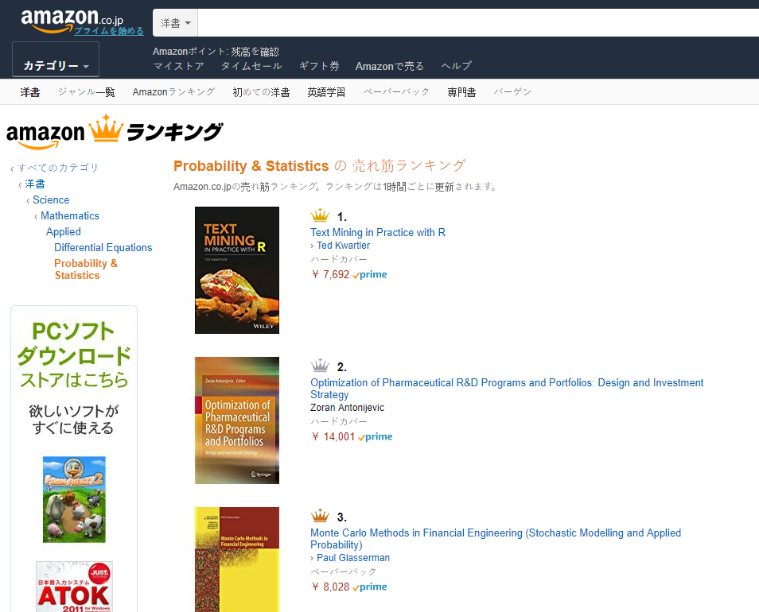

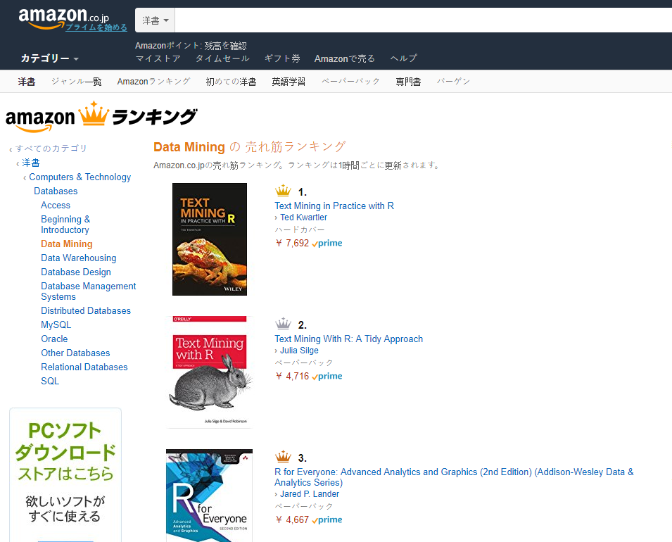

Shameless Plug #1

Slide 3


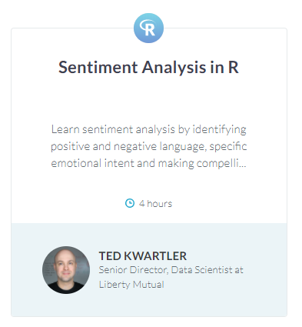
Shameless Plug #2

Slide 4
Agenda
Start | End | Item
 |  | What is Text Mining (TM)?
 |  | Intro to TM w/R
 |  | Break
 |  | Gather Text
 |  | Break
 |  | HTML Widgets/FlexDashboard
 |  | Break
 |  | Task Scheduling
Goals:
Learn the basics of text mining
Apply methods to real ( & messy) data
Follow a business workflow for stakeholders needing text mining insights

Slide 5
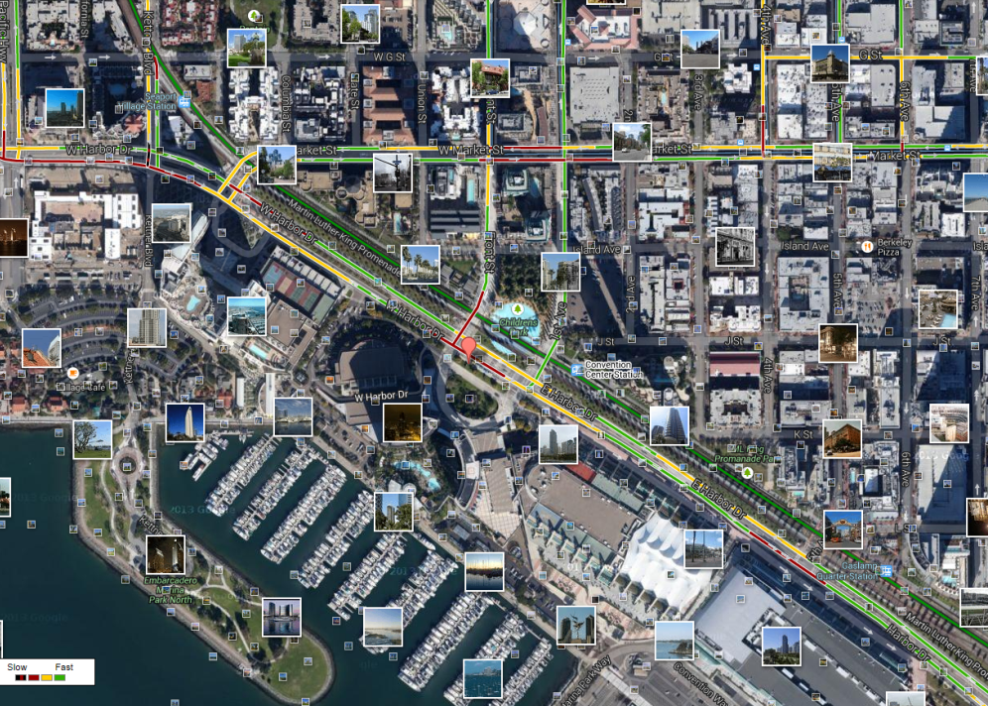
What is Text Mining?
Before Text Mining
Extract new insights from text
Let’s you drink from a fire hose of information
Language is hard; many unsolved problems
Unstructured
Expression is individualistic
Multi-language/cultural implications

Slide 6
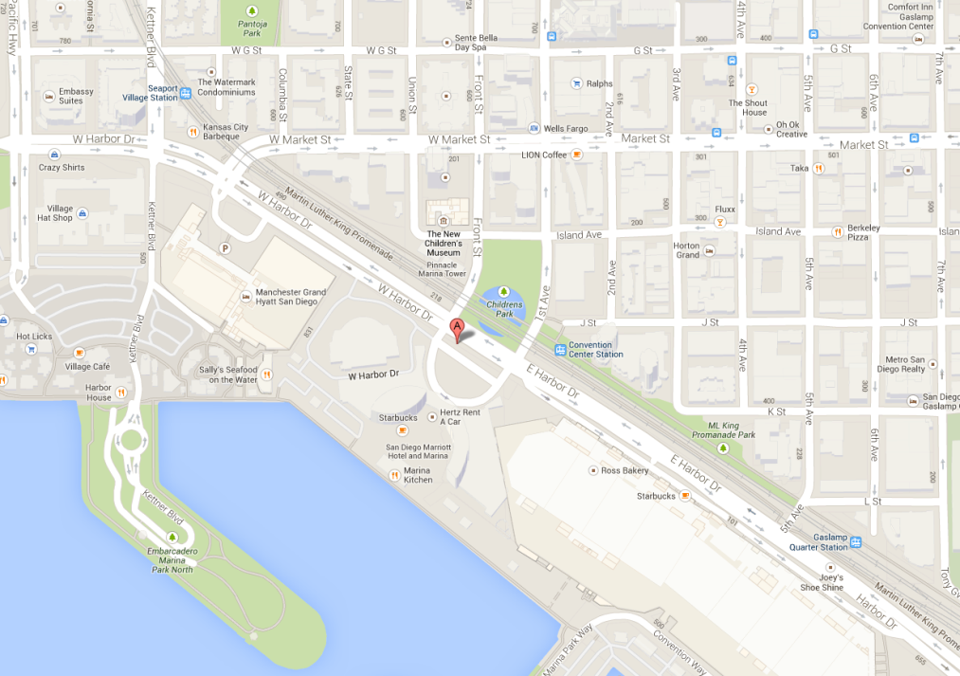
What is Text Mining?
After Text Mining
Extract new insights from text
Let’s you drink from a fire hose of information
Language is hard; many unsolved problems
Unstructured
Expression is individualistic
Multi-language/cultural implications

Slide 7
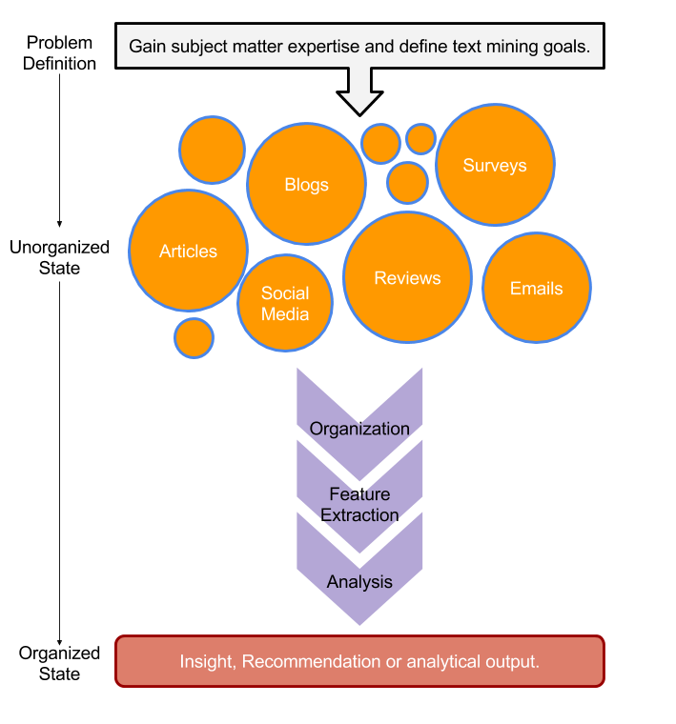
Text Mining Workflow
Problem Definition
Identify Text Sources
Text Organization
Feature Extraction
Analytics
Reach Insight or Recommendation

Slide 8
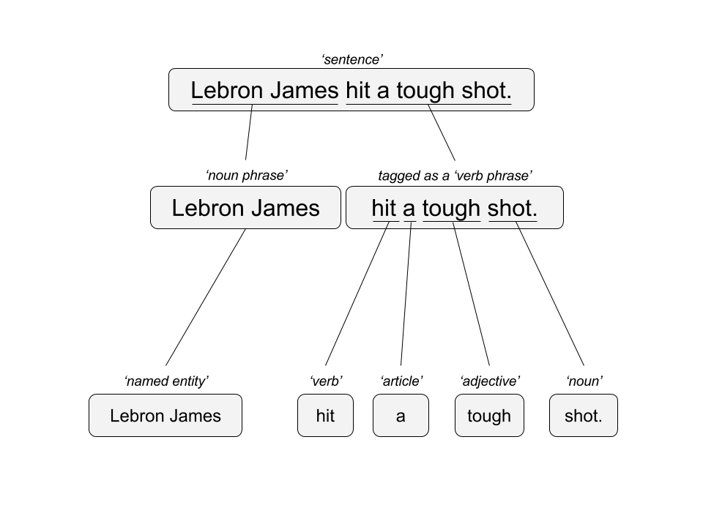

Two Popular Approaches
“Lebron James hit a tough shot.”
Syntactic Parsing
Bag of Words
Lebron
a
James
hit
tough
shot
*There are other approaches usually based on DNN, that I refer to “abstractive”

Slide 9
Why text mining is an art & science?
Challenges because human expression is diverse, often ambiguous, affected by age, demographics, socio-economics, medium/channel & regional attributes of the author.
“I made her duck.”
Compound words (tokenization) change meaning
“not bad” versus “bad”
Disambiguation
Sarcasm
“I like it…NOT!”
Cultural differences
“It’s wicked good” (in Boston)
I cooked waterfowl to eat.
I cooked waterfowl belonging to her.
I created the (clay?) duck and gave it to her.
Duck!!

Slide 10





Why text mining is an art & science?
Challenges because human expression is diverse, often ambiguous, affected by age, demographics, socio-economics, medium/channel & regional attributes of the author.
Text Sources
The channel will have an impact on term uses, spelling, and data integrity.
Books
Electronic Docs (PDFs)
Blogs
Websites
Social Media
Customer Records
Customer Service Notes
Notes
Emails
Legal Documents
…

Slide 11
Agenda
Start | End | Item
 |  | What is Text Mining (TM)?
 |  | Intro to TM w/R
 |  | Break
 |  | Gather Text
 |  | Break
 |  | HTML Widgets/FlexDashboard
 |  | Break
 |  | Task Scheduling
Goals:
Learn the basics of text mining
Apply methods to real ( & messy) data
Follow a business workflow for stakeholders needing text mining insights

Slide 12
In case you ever need to install more than 1 package…here are the ones for today.
# Get CRAN packages
libs<-c('stringi', 'tm', 'qdap', 'ggplot2',
'ggthemes', 'dendextend', 'wordcloud',
'RColorBrewer', 'tidytext', 'treemap',
'portfolio', 'GuardianR', 'lda', 'LDAvis',
'dplyr', 'servr', 'SnowballC', 'openNLP',
'jsonlite', 'pbapply', 'wordcloud2',
'rbokeh', 'radarchart', 'stringr',
'flexdashboard', 'rmarkdown', 'httr')
# Get most of the libs
install.packages(libs)
Don’t run this code, your packages have been preinstalled.

Slide 13
For script scheduling, add the following system specific packages & load a NLP model.
# WINDOWS Scheduler
install.packages('taskscheduleR')
# LINUX Scheduler
install.packages('cronR')
Don’t run this code either, your Linux server has the correct scheduler installed.
# Get a NLP Model for use w/openNLP
install.packages('openNLPmodels.en',
repos = "http://datacube.wu.ac.at/",
type = "source")
This obtains a specific natural language model we will use in the lesson. Its already installed too!

Slide 14

Warning: Twitter Profanity
Twitter demographics skew young and as a result have profanity that appear in the examples. “Keyboard Courage” is rampant.
It’s the easiest place to get a lot of messy text fast, if it is offensive feel free to talk to me and I will work to get you other texts for use on your own. No offense is intended.
#%@*!!!

Slide 15
1_Keyword_Scanning.R
Basic R Unix Commands
Setup
grepl returns a vector of T/F if the pattern is present at least once
grepl(“pattern”, searchable object, ignore.case=TRUE)
grep returns the position of the pattern in the document
grep(“pattern”, searchable object, ignore.case=TRUE)
“library(stringi)” Functions
stri_count counts the number of patterns in a document
stri_count(searchable object, fixed=“pattern”)

Slide 16
Open 1_Keyword_Scanning.R

Slide 17
Remember This?

Slide 18

R for Cleaning Steps
Tomorrow I’m going to have a nice glass of Chardonnay and wind down with a good book in the corner of the county :-)
Remove Punctuation
Remove extra white space
Remove Numbers
Make Lower Case
Remove “stop” words
blogs
reviews
articles
tomorrow going nice glass chardonnay wind down good book corner county

Slide 19
Library TM Functions
VCorpus creates a corpus held in memory.
VCorpus(source)
tm_map applies the transformations for the cleaning
tm_map(corpus, function)
getTransformations() will list all standard tm corpus transformations. We can apply string functions from other packages with content_transformer(FUNCTION)
tm_map(corpus, removePunctuation) - removes punctuation from the documents
tm_map(corpus, stripWhitespace) - extra spaces, tabs are removed
tm_map(corpus, removeNumbers) - removes numbers
tm_map(corpus, content_transformer(tolower)) – makes all case lower
tm_map(corpus, removeWords) - removes specific “stopwords”
New Text Mining Concepts
Corpus- A collection of documents that analysis will be based on.
Stopwords – are common words that provide very little insight, often articles like “a”, “the”. Customizing them is sometimes key in order to extract valuable insights.
7/16/2018
Kwartler CSCI S-96
19

Slide 20
Library qdap Functions
VCorpus creates a corpus held in memory.
mgsub(“search pattern”, “replacement pattern”, text object)
Family of Replace Functions
replace_abbreviation()- Replace Abbreviations
replace_contraction()- Replace Contractions
replace_number()- Replace Numbers With Text Representation
replace_ordinal()- Replace Mixed Ordinal Numbers With Text Representation
replace_symbol()- Replace Symbols with Word Equivalents
To use on a corpus you need to apply content_transformer
tm_map(corpus, content_transformer(replace_abbreviation))
New Text Mining Concepts
Lemmatization in linguistics, is the process of grouping together the different inflected forms of a word so they can be analyzed as a single item.
7/16/2018
Kwartler CSCI S-96
20

Slide 21
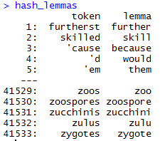
Poor Man’s Lemmatization
library(lexicon)
Qdap’s mgsub function can help you lemmatize words.
Bring in a lessatization lexicon.
Supply a vector of patterns to search for’
Supply a vector of patters to replace or change into.
Specify the vector the lexicon and substitutions should be applied to.
# Poor Man's Lemmatization
data(hash_lemmas)
text$text <- mgsub(hash_lemmas$token,hash_lemmas$lemma,text$text)
Warning,: Not done in class because it takes a long time.

Slide 22
Custom Functions in 2_Cleaning_and_Frequency_Count.R
“tryTolower” is poached to account for errors when making lowercase.
tryTolower <- function(x){
# return NA when there is an error
y = NA
# tryCatch error
try_error = tryCatch(tolower(x), error = function(e) e)
# if not an error
if (!inherits(try_error, 'error'))
y = tolower(x)
return(y)}
“clean.corpus” makes applying all transformations easier.
cleanCorpus<-function(corpus){
corpus <- tm_map(corpus, content_transformer(qdapRegex::rm_url))
corpus <- tm_map(corpus, removePunctuation)
corpus <- tm_map(corpus, stripWhitespace)
corpus <- tm_map(corpus, removeNumbers)
corpus <- tm_map(corpus, content_transformer(tryTolower))
corpus <- tm_map(corpus, removeWords, customStopwords)
return(corpus)
}
Base: tolower (basic)
Stringr: str_to_lower (wrapper)
Custom: tryTolower (handles errors)

Slide 23
Nuances & Inputs for Setting Up a TM Project
“custom.stopwords” combines vectors of words to remove from the corpus
#Create custom stop words
customStopwords <- c(stopwords('english'), 'lol', 'smh')
Add channel specific stop words.
E.g. Twitter abbreviations
Retaining Meta Data Information
# Data
text<-read.csv('coffee.csv', header=TRUE)
# As of tm version 0.7-3 tabular was deprecated
names(text)[1]<-'doc_id' #first 2 columns must be 'doc_id' & 'text‘
txtCorpus <- VCorpus(DataframeSource(text))
txtCorpus<-cleanCorpus(txtCorpus)

Slide 24
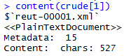
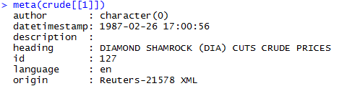
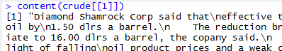
How do you retain meta information?
meta(crude[[1]])
What is Meta?
What is content?
Meta information is data associated with the data you are analyzing. These can add context and allow you to partition data in insightful ways.
Timestamp (pre 9/11 Vs post 9/11)
Language (American Vs King’s English)
Author (Trump Vs Clinton)
Channel (Twitter)
Content is simply the text (strings) you are analyzing. These data points represent the information of interest you are looking to gain insights from.
Retaining/Extracting Meta
Examining Content
meta(crude[[1]]) # Get the first document of a corpus’ meta data i.e. Author etc.
Brackets Matter!!
During an analysis it may be helpful to examine both meta & content information.

Slide 25
For Bag of Words, how is data organized?
Term Document Matrix
Document Term Matrix
 | Tweet1 | Tweet2 | Tweet3 | Tweet4 | … | Tweet_n
Term1 | 0 | 0 | 0 | 0 | 0 | 0
Term2 | 1 | 1 | 0 | 0 | 0 | 0
Term3 | 1 | 0 | 0 | 2 | 0 | 0
… | 0 | 0 | 3 | 0 | 1 | 1
Term_n | 0 | 0 | 0 | 1 | 1 | 0
 | Term1 | Term2 | Term3 | … | Term_n
Tweet1 | 0 | 1 | 1 | 0 | 0
Tweet2 | 0 | 1 | 0 | 0 | 0
Tweet3 | 0 | 0 | 0 | 3 | 0
… | 0 | 0 | 0 | 1 | 1
Tweet_n | 0 | 0 | 0 | 1 | 0
Code to Create the DTM/TDM and change to a matrix
Why are DTM & TDM Sparse? What do they represent?
txtDtm<-DocumentTermMatrix(txtCorpus)
txtTdm<-TermDocumentMatrix(txtCorpus)
txtDtmM<-as.matrix(txtDtm)
txtTdmM<-as.matrix(txtTdm)
The matrices are sparse (many 0’s) so additional steps may be needed to extract information.

Slide 26
Open 2_Cleaning_and_Frequency_Count.R

Slide 27
Agenda
Start | End | Item
 |  | What is Text Mining (TM)?
 |  | Intro to TM w/R
 |  | Break
 |  | Gather Text
 |  | Break
 |  | HTML Widgets/FlexDashboard
 |  | Break
 |  | Task Scheduling
Goals:
Learn the basics of text mining
Apply methods to real ( & messy) data
Follow a business workflow for stakeholders needing text mining insights

Slide 28
Once cleaned, let’s get word frequencies.
beerFreq<-rowSums(beerTDMm)
beerFreq<-data.frame(word=names(beerFreq),frequency=beerFreq)
Term Document Matrix
Word Frequency Matrix
 | Tweet1 | Tweet2 | Tweet3 | Tweet4 | … | Tweet_n
Term1 | 0 | 0 | 0 | 0 | 0 | 0
Term2 | 1 | 1 | 0 | 0 | 0 | 0
Term3 | 1 | 0 | 0 | 2 | 0 | 0
… | 0 | 0 | 3 | 0 | 1 | 1
Term_n | 0 | 0 | 0 | 1 | 1 | 0
word | freq
Term1 | 0
Term2 | 2
Term3 | 3
… | 5
Term_n | 2

Slide 29
What about a DTM?
beerFreq<-???????(beerDTMm)
beerFreq<-data.frame(word=names(beerFreq),frequency=beerFreq)
Document Term Matrix
Word Frequency Matrix
 | Term1 | Term2 | Term3 | … | Term_n
Tweet1 | 0 | 1 | 1 | 0 | 0
Tweet2 | 0 | 1 | 0 | 0 | 0
Tweet3 | 0 | 0 | 0 | 3 | 0
… | 0 | 0 | 0 | 1 | 1
Tweet_n | 0 | 0 | 0 | 1 | 0
word | freq
Term1 | 0
Term2 | 2
Term3 | 3
… | 5
Term_n | 2
Can anyone think of how you could get a DTM to be a WFM?

Slide 30
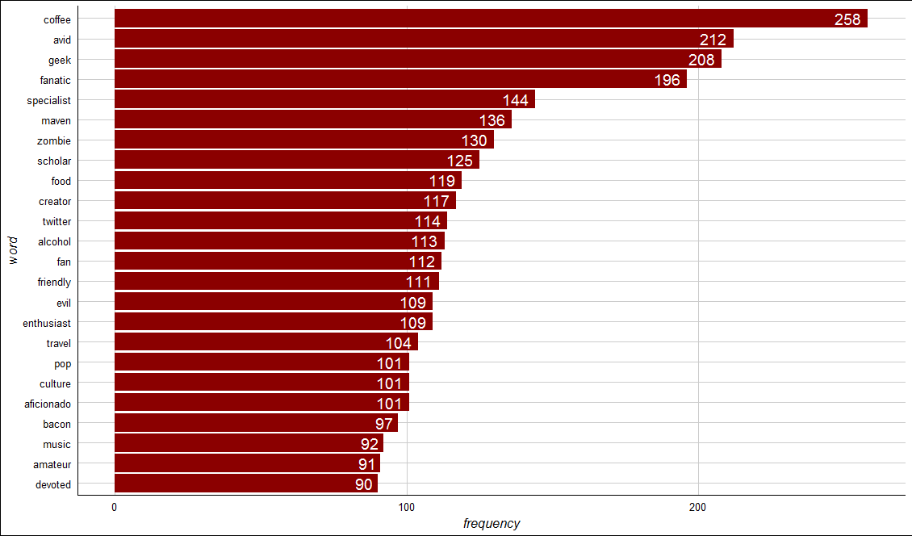
Open 3_Dendrogram.R to visualize the WFM

Slide 31
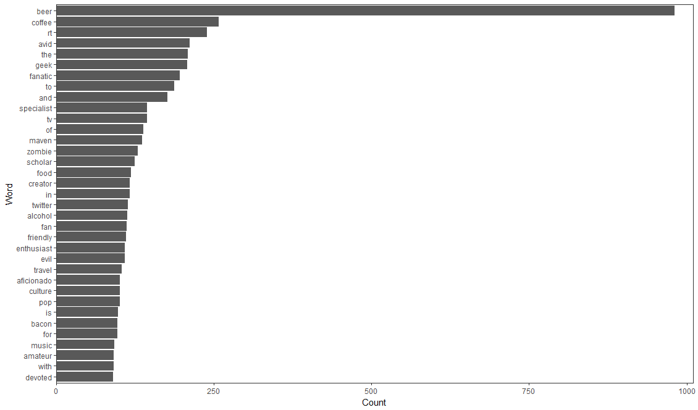

Open 3_Dendrogram.R to visualize the WFM

Slide 32
Zombies!! Word Association
# Inspect word associations
associations<-findAssocs(beerTDM, 'zombie', 0.30)
# Make a dot plot
zombieDF<-data.frame(terms=names(associations[[1]]),
value=unlist(associations))
zombieDF$terms<-factor(zombieDF$terms, levels=zombieDF$terms)
ggplot(zombieDF, aes(y=terms)) +
geom_point(aes(x=value), data=zombieDF, col='#c00c00') +
theme_gdocs() +
geom_text(aes(x=value,label=value), colour="red",hjust=-.25, size=3)
Adjust 0.30 to get the terms that are associated .30 or more with the ‘zombie’ term.
Treating the terms as factors lets ggplot2 sort them for a cleaner look.
Word Association is similar to correlation. When word A appears, how often does word B? Unlike correlation, terms can only be positively associated. This is because there are so many terms that everything would be “negatively correlated (asoociated).

Slide 33
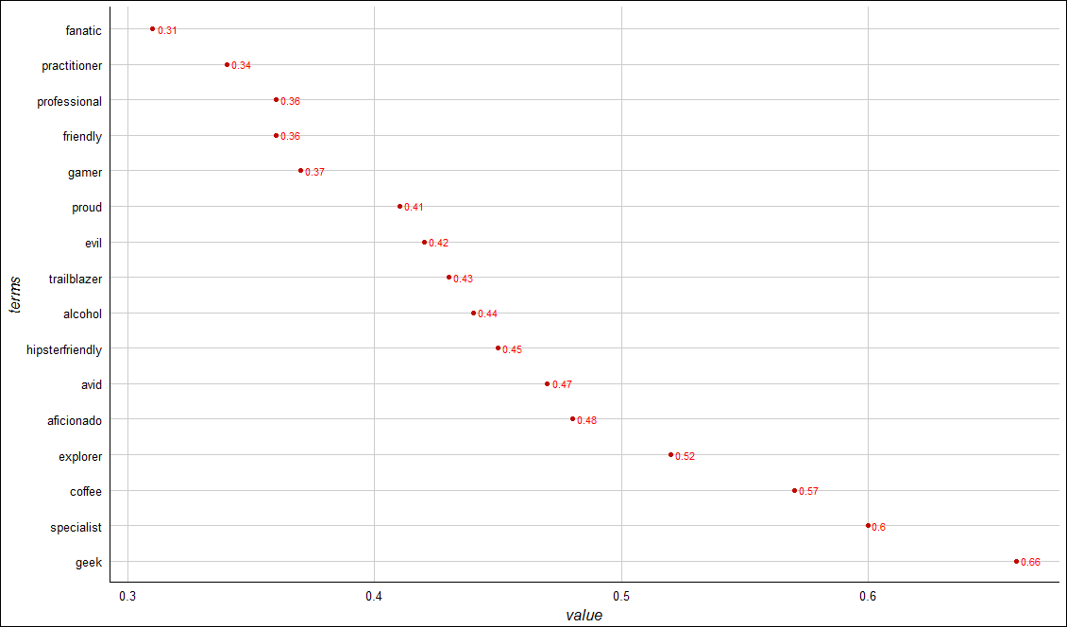
Zombies!! Word Association
Geek has the highest word association with “zombie”
Alcohol geek. Avid tv buff. Friendly beer aficionado. Coffee guru. Zombie junkie.

Slide 34
Dendrograms
Real Rainfall Data
Rainfall Data as a Dendrogram
City | Annual Rainfall
Portland | 43.5
Boston | 43.8
New Orleans | 62.7
63
44
Keep in Mind a Dendrogram
New Orleans
Reduces information much like average is a reduction of many observations’ values
Word clusters emerge often showing related terms
Term frequency is used to construct the word cluster. Put another way, term A & term B have similar freq. distances & are considered a cluster
Boston
Portland
Boston & Portland are a cluster at height 44, losing precision to create the cluster.
Visualizes hierarchical data. For text, the frequency distances are calculated to create the hc object.

Slide 35
Dealing with Sparsity
Real Rainfall Data
Rainfall Data as a Dendrogram
City | Annual Rainfall
Portland | 43.5
Boston | 43.8
New Orleans | 62.7
63
44
Keep in Mind a Dendrogram
New Orleans
Reduces information much like average is a reduction of many observations’ values
Word clusters emerge often showing related terms
Term frequency is used to construct the word cluster. Put another way, term A & term B have similar freq. distances & are considered a cluster
Boston
Portland
Boston & Portland are a cluster at height 44, losing precision to create the cluster.
Visualizes hierarchical data. For text, the frequency distances are calculated to create the hc object.

Slide 36
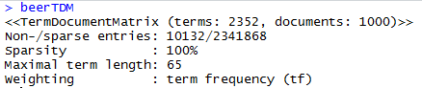
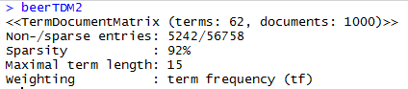
3_Dendrogram.R
Setup
Weird associations! Maybe a dendrogram will help us more
# Reduce TDM
beerTDM2 <- removeSparseTerms(beerTDM, sparse=0.97) #shoot for ~50 terms
beerTDM2<-as.data.frame(as.matrix(beerTDM2))
% of zeros allowed
e.g. higher means more words in TDM/DTM
New Text Mining Concept
Sparse- Term Document Matrices are often extremely sparse. This means that any document (column) has mostly zero’s. Reducing the dimensions of these matrices is possible by specifying a sparse cutoff parameter. Higher sparse parameter will bring in more terms.

Slide 37
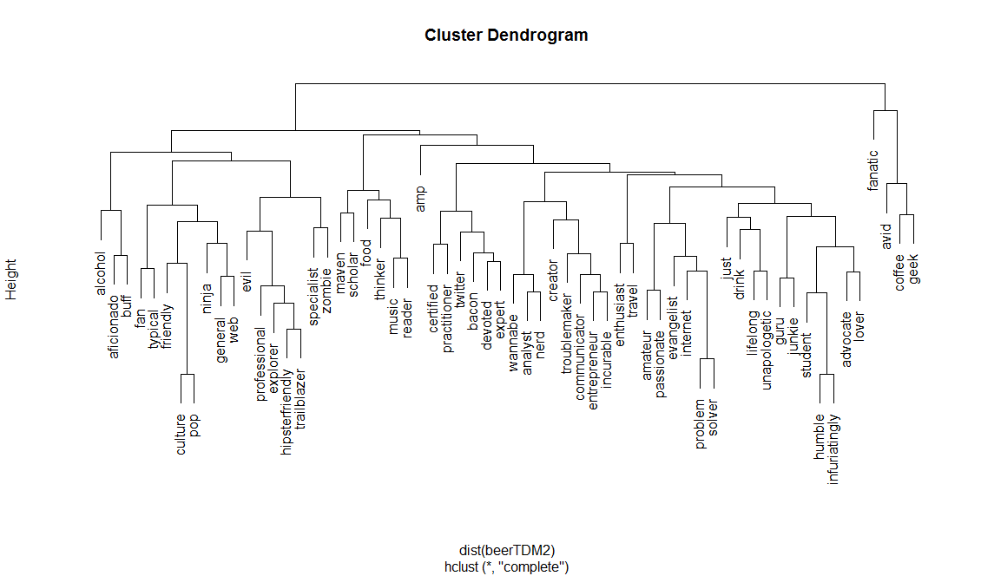
3_Dendrogram.R
Base Plot of a Dendrogram
Less visually appealing
Clusters can be hard to read given the different heights

Slide 38
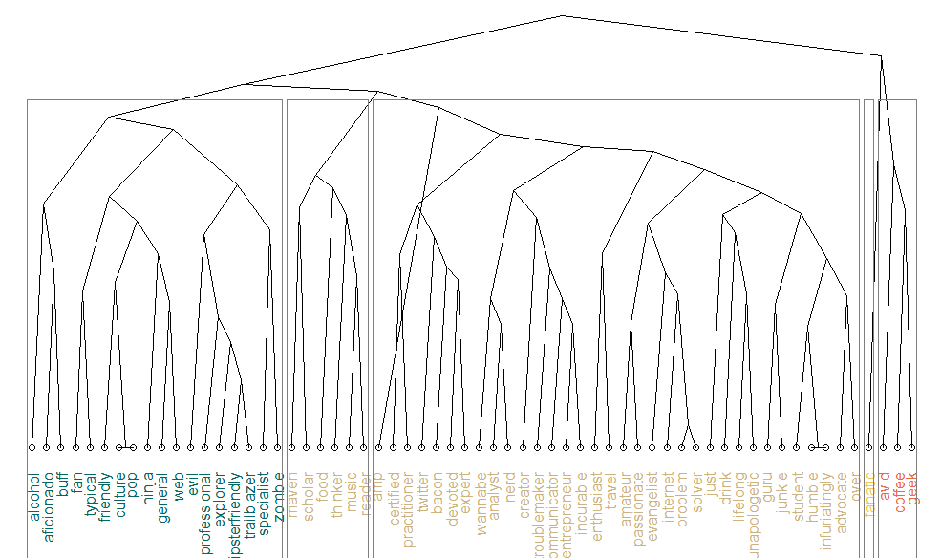
3_Dendrogram.R
Dendextend offers more flexibility

Slide 39
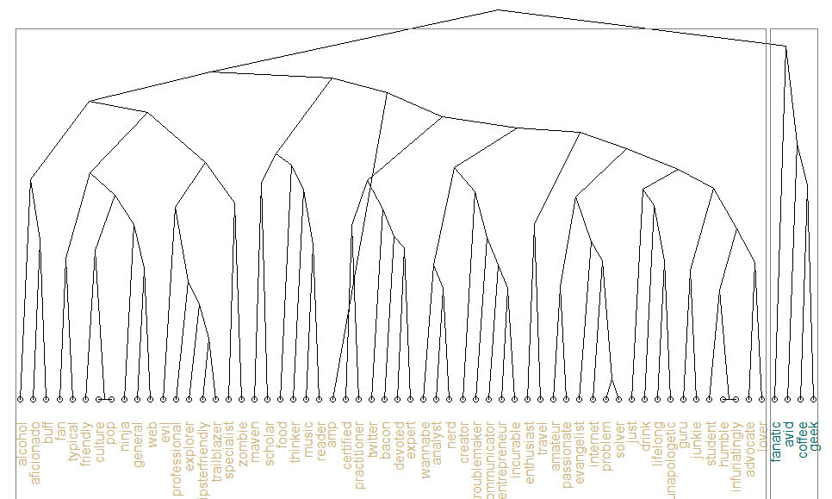
3_Dendrogram.R
Dendextend offers more flexibility

Slide 40
3_Dendrogram.R

Slide 41
Intro to TM w/R Deep Dive
What is Text Mining?
String Manipulation & Cleaning
Frequency Counts, Dendrograms & Wordclouds
Sentiment Analysis
Topic Modeling
OpenNLP/Named Entity Recognition
Goals:
Learn the basics of text mining
Apply methods to real data and uses
Follow a business workflow for stakeholders needing text mining insights

Slide 42
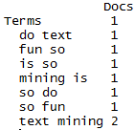
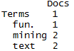
4_Simple_Wordcloud.R
#bigram token maker
bigramTokens <-function(x)
unlist(lapply(NLP::ngrams(words(x), 2), paste, collapse = " "), use.names = FALSE)
wineTDM<-TermDocumentMatrix(txtCorpus, control=list(tokenize=bigramTokens))
Text Mining is so fun. So do Text Mining!
Unigram
Bigram
*with common stopwords
New Text Mining Concept
Tokenization- So far we have created single word n-grams. We can create multi word “tokens” like bigrams, or trigrams with this line function. It is applied when making the term document matrix.

Slide 43
4_Simple_Wordcloud.R
To make a wordcloud we follow the previous steps and create a data frame with the word and the frequency.
# Get Row Sums
wineTDMv <- sort(rowSums(wineTDMm),decreasing=TRUE)
wineDF <- data.frame(word = names(wineTDMv),freq=wineTDMv)
Term Document Matrix
 | Tweet1 | Tweet2 | Tweet3 | Tweet4 | … | Tweet_n
Term1 | 0 | 0 | 0 | 0 | 0 | 0
Term2 | 1 | 1 | 0 | 0 | 0 | 0
Term3 | 1 | 0 | 0 | 2 | 0 | 0
… | 0 | 0 | 3 | 0 | 1 | 1
Term_n | 0 | 0 | 0 | 1 | 1 | 0
word | freq
Term1 | 0
Term2 | 2
Term3 | 3
… | 5
Term_n | 2
Setup

Slide 44
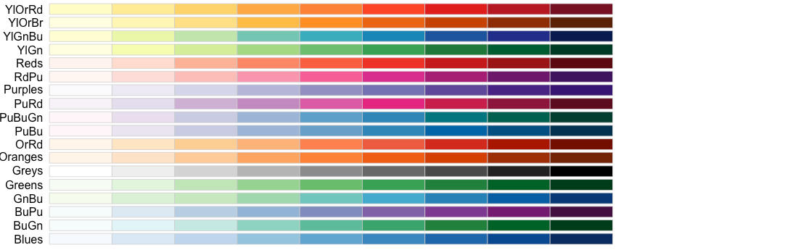
4_Simple_Wordcloud.R
Next we need to select the colors for the wordcloud.
# Review all Pallettes
display.brewer.all()
# Choose a color & drop light ones
pal <- brewer.pal(8, "Blues")
pal <- pal[-(1:2)]

Slide 45
4_Simple_Wordcloud.R

Slide 46
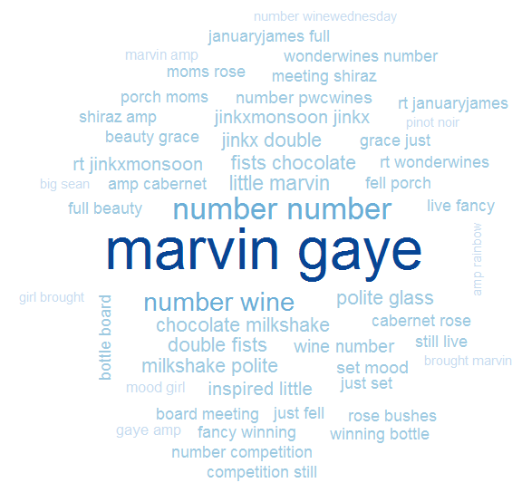
4_Simple_Wordcloud.R
set.seed(1234)
wordcloud(wineDF$word,wineDF$freq,max.words=50, random.order=FALSE, colors=pal)
Bigram Tokenization has captured “marvin gaye”
A word cloud is a frequency visualization. The larger the term (or bigram here) the more frequent the term.
You may get warnings if certain tokens are to large to be plotted in the graphics device.
In cleanCopurs() the function … changes numeric with the generic string “number” so be careful with your preprocessing steps!

Slide 47
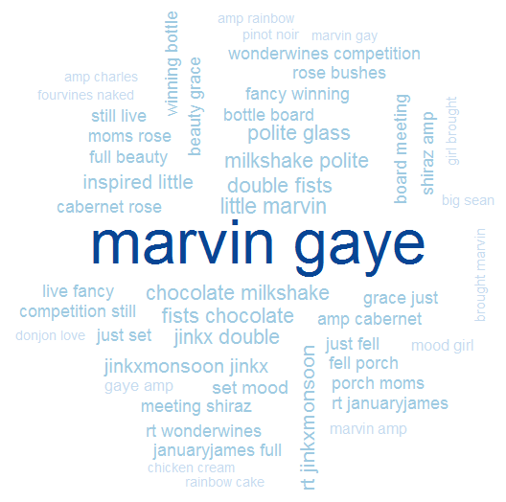
4_Simple_Wordcloud.R
In cleanCopurs() the function replace_symbol() changes numeric with the generic string “number” so be careful with your preprocessing steps!

Slide 48
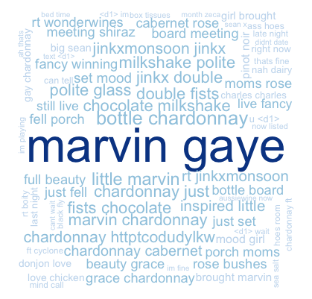
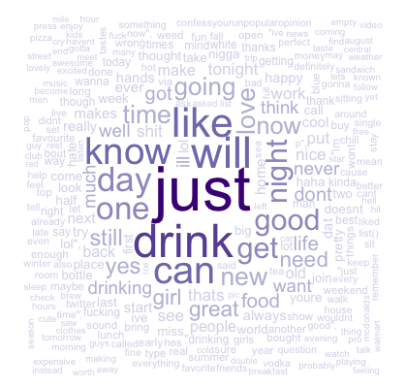
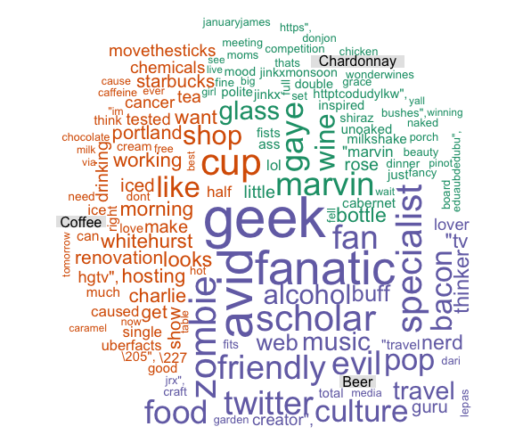
Types of Wordclouds
Multiple Corpora
Single Corpus
wordcloud( )
comparison.cloud( )
commonality.cloud( )
comparison.cloud( )
comparison.cloud( )

Slide 49
5_Other_Wordclouds.R
The challenge is working with multiple corpora efficiently. Many ways to do it…
# Read in multiple files as individuals
txtFiles<-c('chardonnay.csv','coffee.csv','beer.csv') #use list.files() for a lot
for (i in 1:length(txtFiles)){
assign(txtFiles[i], read.csv(txtFiles[i]))
cat(paste('read completed:',txtFiles[i],'\n'))
}
# Read them into a single list with individual elements
all<-pblapply(txtFiles,read.csv)
Two ways to import csv files:
Each file is read in and an object created for each.
A list called “all” is created. Each list element represents a single document. Using data.table::rbindlist() one can create a single document from all files in the folder.

Slide 50
5_Other_Wordclouds.R

Slide 51
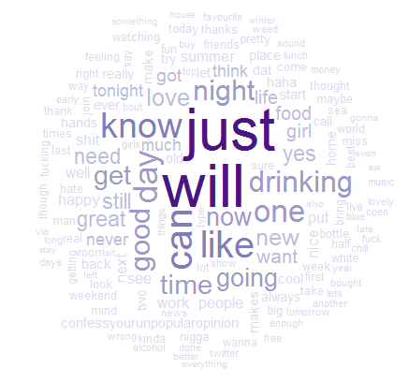
Commonality Cloud
The tweets mentioning “chardonnay” “beer”, and “coffee” have these words in common.
Again size is related to frequency.
Not helpful in this but in diverse corpora it may be more helpful e.g. political speeches.
# Make commonality cloud
commonality.cloud(drinkTDMm, max.words=150, random.order=FALSE,colors=pal)

Slide 52
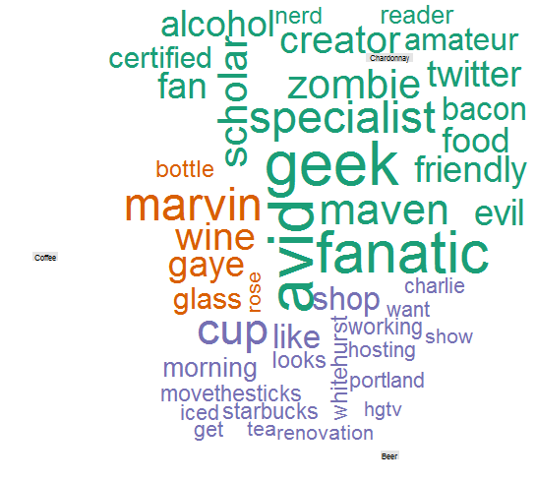
Comparison Cloud
The tweets mentioning “chardonnay” “beer”, and “coffee” have these dissimilar words.
Again size is related to frequency.
Beer drinkers in this snapshot are passionate (fanatics, geeks, specialists) on various subjects while Chardonnay drinkers mention Marvin Gaye. Coffee mentions up & working.
# Make comparison cloud
comparison.cloud(drinkTDMm, max.words=75, random.order=FALSE, title.size=0.5,colors=brewer.pal(ncol(drinkTDMm),"Dark2"))

Slide 53
Intro to TM w/R Deep Dive
What is Text Mining?
String Manipulation & Cleaning
Frequency Counts, Dendrograms & Wordclouds
Sentiment Analysis
Topic Modeling
OpenNLP/Named Entity Recognition
Goals:
Learn the basics of text mining
Apply methods to real data and uses
Follow a business workflow for stakeholders needing text mining insights

Slide 54
Simple Sentiment Polarity
Scoring
Zipf’s Law
Surprise is a sentiment.
Hit by a bus! – Negative Polarity
Won the lottery!- Positive Polarity
Many words in natural language but there is steep decline in everyday usage. Follows a predictable pattern.
I loathe BestBuy Service -1
I love BestBuy Service. They are the best. +2
I like shopping at BestBuy but hate traffic. 0
R’s QDAP polarity function scans for positive words, and negative words as defined by MQPA Academic Lexicon research. It adds positive words and subtracts negative ones along with valence shifters. The final score represents the polarity of the social interaction.

Slide 55
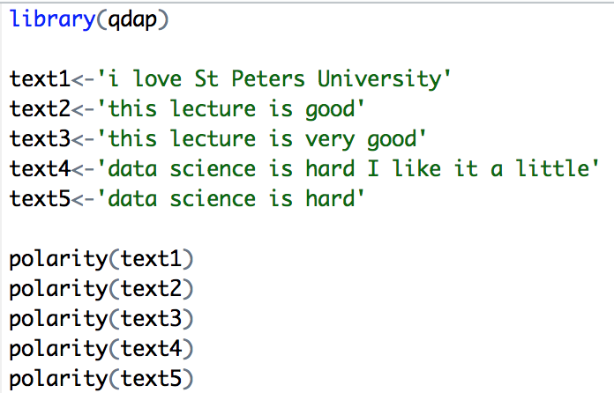
Simple Sentiment Polarity
Scoring
Text 1: “love” was identified as positive. The text has 5 words and so 1/sqrt(5) = .447
Text 2: “good” was identified positively. So 1/sqrt(4)=.5
Text 3: “good” was found along with the amplifier “very”. So (.8+1)/sqrt(5)=.805
Text 4: hard and like cancel each other out so the polarity is zero. 1-1/sqrt(9)=0
Text 5: “hard” is -1/sqrt(4)=-.50
First it looks for the polarized word. Then identifies valence shifters (default 4 words before and two words after) Amplifiers are assigned +.8 and de-amplifiers weight is constrained to -1. Lastly the sum is divided by the square root of the total number of words in the passage.

Slide 56
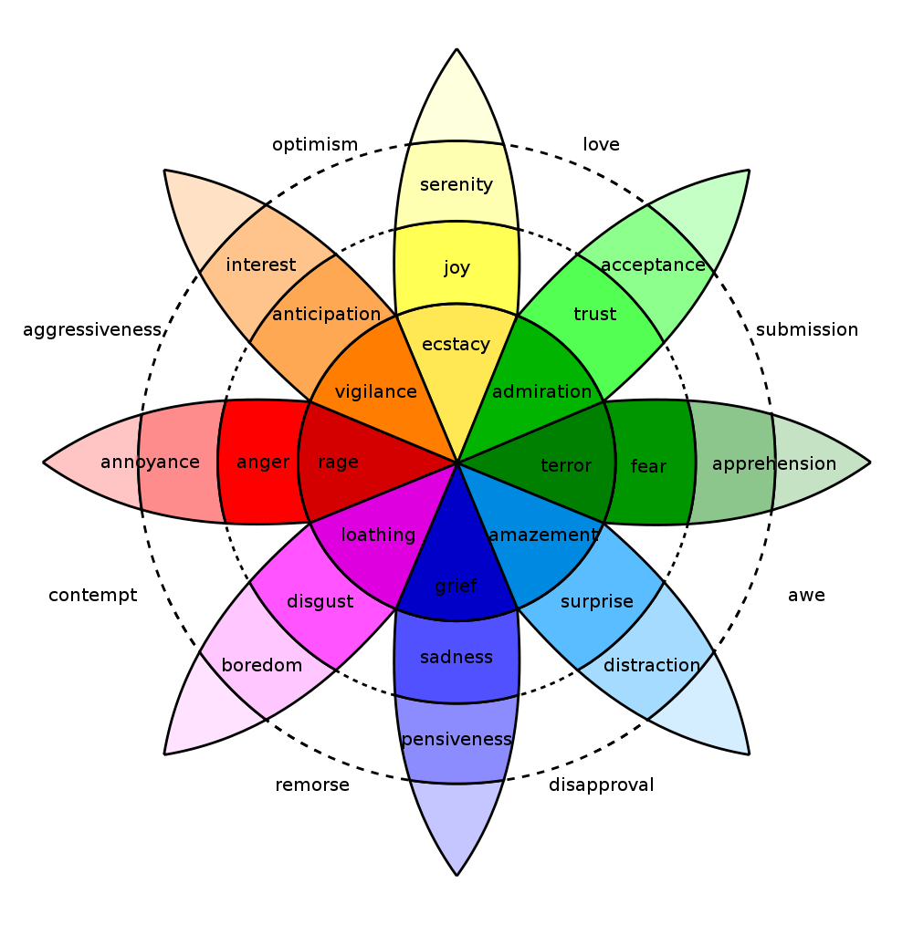
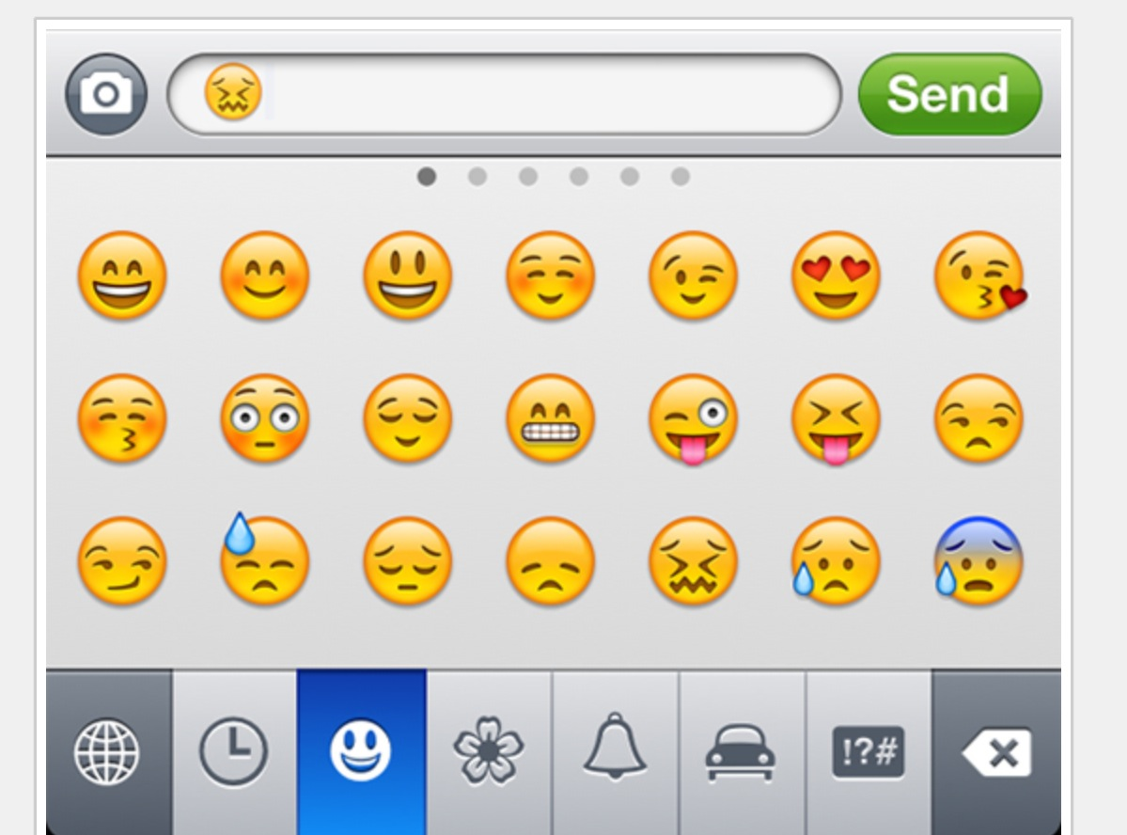
In reality sentiment is more complex.
Many Many Emoji
Plutchik’s Wheel

Slide 57
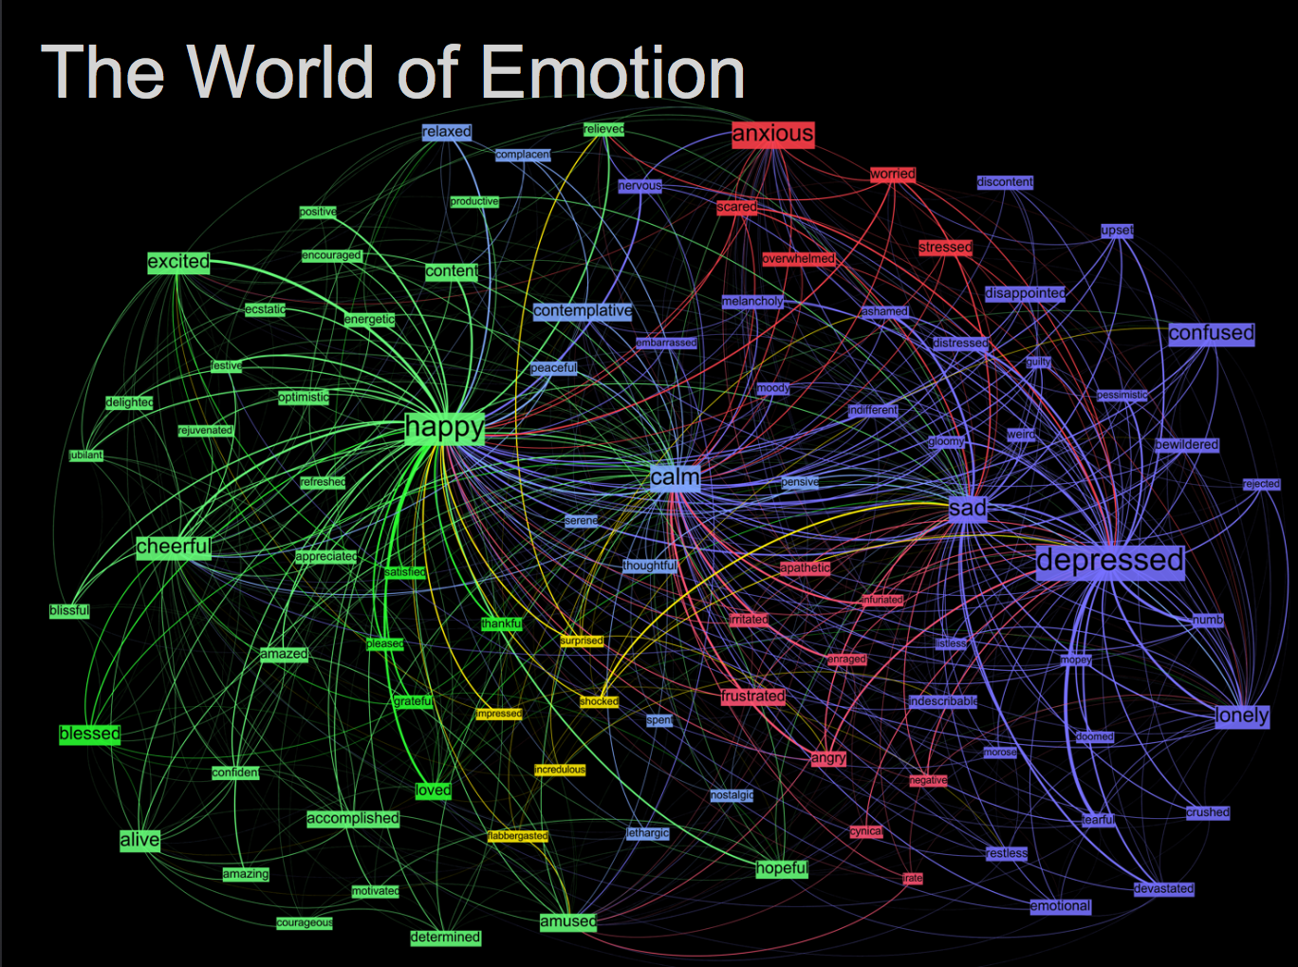
Kanjoya’s Experience Corpus

Slide 58
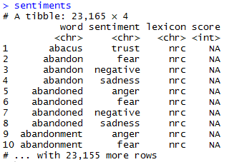
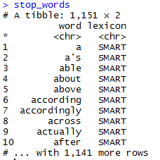
Sentiment the Tidy Way!
##Tidy Sentiment Analysis
data(sentiments)
sentiments
#Stopwords
data(stop_words)
stop_words
#Add stopwords
custom.stopwords<-data.frame(word=c('amp','beer'),
lexicon='custom')
stop_words<-rbind(stop_words,custom.stopwords)

Slide 59
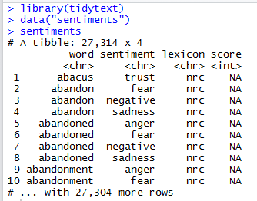
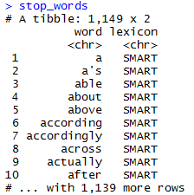
6_TidyText_Sentiment.R
Tidytext is part of the tidy universe including ggplot and dplyr. Code is structured so it is more easily read using the %>%. The data format is a tibble and is in “tidy” format (long form).
mtcars %>% group_by(cyl) %>% mutate(rank = min_rank(desc(mpg)))
This reads as “Using the mtcars object then group by the cyl vector then mutate a new variable called rank.

Slide 60
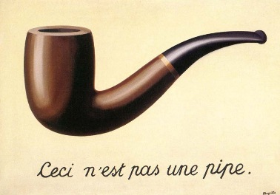

Slide 61
6_TidyText_Sentiment.R
The pipe operator
%>%
Forwards an object so the code is easy to understand & concise.
Tweet words
Stop words
all.tidy <- all.tidy %>%
anti_join(stop_words)
anti_join()
text
Sentiment words
all.sentiment <- all.tidy %>%
inner_join(nrc.lexicon) %>%
count(tweet,sentiment) %>%
spread(tweet, n, fill = 0)
inner_join()

Slide 62
6_TidyText_Sentiment.R
# DTM
txtDTM<-DocumentTermMatrix(txtCorpus)
txtDTM
dim(txtDTM)
# Tidy
tidyCorp<-tidy(txtDTM)
tidyCorp
dim(tidyCorp)
# Get bing lexicon
# "afinn", "bing", "nrc", "loughran"
bing<-get_sentiments(lexicon = c("bing"))
head(bing)
# Perform Inner Join
bingSent<-inner_join(tidyCorp,bing, by=c('term'='word'))
DTM is from the “tm” library
Easy way to make it into a tibble.
Weeknd Lyrics
Bing Lexicon

Slide 63
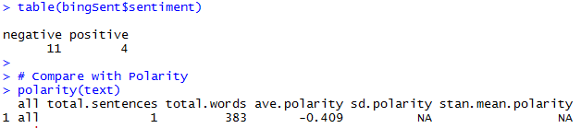
6_TidyText_Sentiment.R
The polarity function from qdap and the inner_join show similar negative results.
Weeknd Lyrics
Bing Lexicon

Slide 64
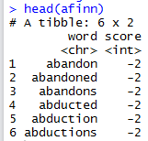
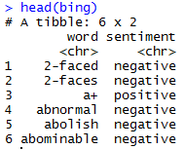
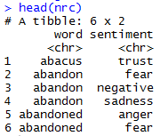
6_TidyText_Sentiment.R
The sentiments tibble has multiple lexicons. Each can be used in an inner join to get different ways of assessing sentiment.
AFINN- Dutch researcher
Words scored -5 to 5
Bing- UofI-Chi Researcher
Words scored Pos/Neg
NRC – mTurk
Words classified into 8 primary & pos/neg
Weeknd Lyrics
Bing Lexicon

Slide 65
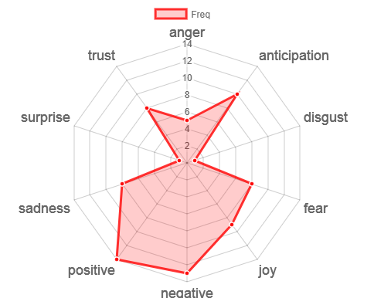
Remember Plutchik’s Wheel of emotion? Let’s mimic it!
You could remove Pos/Neg before making the radarchart to more closely fit the wheel.

Slide 66
6_TidyText_Sentiment.R

Slide 67
Intro to TM w/R Deep Dive
What is Text Mining?
String Manipulation & Cleaning
Frequency Counts, Dendrograms & Wordclouds
Sentiment Analysis
Topic Modeling
OpenNLP/Named Entity Recognition
Goals:
Learn the basics of text mining
Apply methods to real data and uses
Follow a business workflow for stakeholders needing text mining insights

Slide 68
Topic Modeling
LDA
Example
Each document is made up of mini topics.
Corpus
I like to watch basketball and football on TV.
I watched basketball and Shark Tank yesterday.
Open source analytics software is the best.
R is an open source software for analysis.
I use R for basketball analytics.
Probability is assigned to each document for the specific observed topics.
A document can have varying probabilities of topics simultaneously.
LDA Topics
Topic A: 30% basketball, 20% football, 15% watched, 10% TV…something to do with watching sports
Topic B: 40% software, 10% open, 10% source…10% analytics something to do with open source analytics software
Technical Explanations:
http://en.wikipedia.org/wiki/Latent_Dirichlet_allocation
http://cs.brown.edu/courses/csci2950-p/spring2010/lectures/2010-03-03_santhanam.pdf
*Full disclosure I am not an expert in topic modeling
Documents
100% Topic A
100% Topic A
100% Topic B
100% Topic B
60% Topic B, 40% Topic A

Slide 69
7_TopicModeling_Sentiment.R
LDA Topic Modeling
Setup
library(topicmodels) is not actively maintained. So, library(lda) is used here.
txtLex<-lexicalize(txt)
Reads raw text, and creates a corpus of n “articles”, and complete word lexicon.
txtWordCount<-word.counts(txtLex$documents, txtLex$vocab)
txtDocLength<-document.lengths(txtLex$documents)
Word counts for each article
Number of words in each article
# LDA Topic Modeling
k <- 5
num.iter <- 25
alpha <- 0.02
eta <- 0.02
set.seed(1234)
fit <- lda.collapsed.gibbs.sampler(documents = txtLex$documents, K = k,vocab = txtLex$vocab,
num.iterations = num.iter,alpha = alpha, eta = eta,
initial = NULL, burnin = 0,compute.log.likelihood = TRUE)
Parameters
Model Fit

Slide 70
7_TopicModeling_Sentiment.R
Setup
LDA Topic Modeling
One of the cool things about lda is that you can find the prototypical document
# Prototypical Document
top.topic.documents(fit$document_sums,1)
[1] 21 23 2 24 3
Since K= 5, the 21 article best represents the first topic and so on.
> text$webTitle[21]
[1] "A little shared knowledge goes a long way in helping to scale social enterprise"

Slide 71
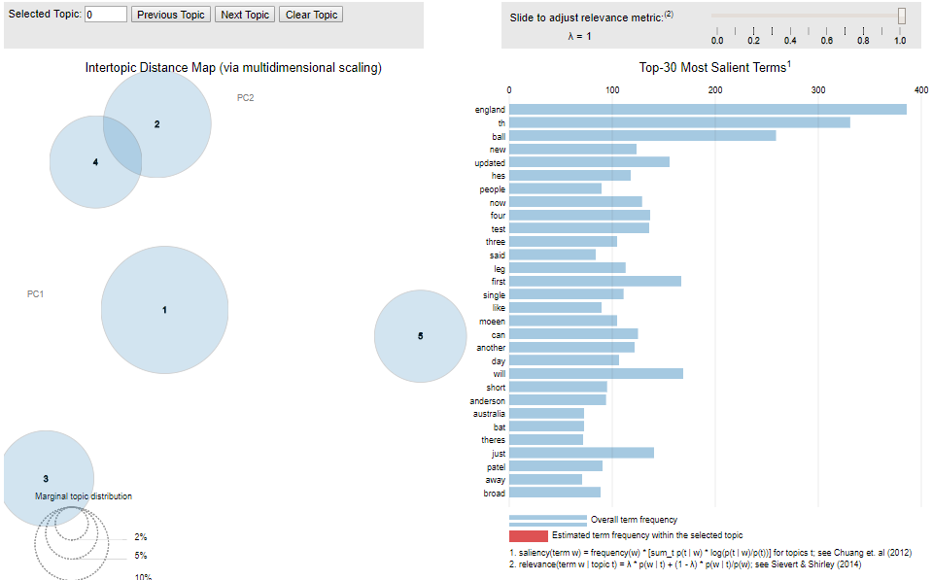
7_TopicModeling_Sentiment.R
Setup
Better yet, let’s explore in a dynamic gui w/ ldaVis
# LDAvis params
theta <- t(pbapply(fit$document_sums + alpha, 2, function(x) x/sum(x)))
phi <- t(pbapply(t(fit$topics) + eta, 2, function(x) x/sum(x)))
ldaJSON <- createJSON(phi = phi,
theta = theta,
doc.length = txtDocLength,
vocab = txtLex$vocab,
term.frequency = as.vector(txtWordCount))
serVis(ldaJSON)

Slide 72
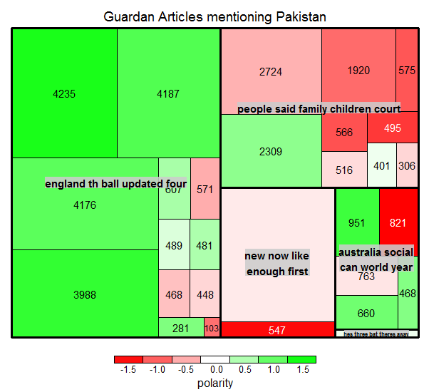
7_TopicModeling_Sentiment.R
Setup
TREEMAP: multi dimensional representation of the corpus attributes.
Each article is a small square
The area of the square is related to the number of terms document length
Color will represent quick, simple polarity from qdap
The larger grouping is based on LDA topic assignment
End result is understanding broad topics, their sentiment and amount of the corpus documents devoted to the identified topic.

Slide 73
7_TopicModeling_Sentiment.R

Slide 74
Intro to TM w/R Deep Dive
What is Text Mining?
String Manipulation & Cleaning
Frequency Counts, Dendrograms & Wordclouds
Sentiment Analysis
Topic Modeling
OpenNLP/Named Entity Recognition
Goals:
Learn the basics of text mining
Apply methods to real data and uses
Follow a business workflow for stakeholders needing text mining insights

Slide 75

Remember this? Text Mining Approaches
“Lebron James hit a tough shot.”
Semantic Using Syntactic Parsing
Bag of Words
Lebron
a
James
hit
tough
shot

Slide 76

Named Entity Recognition using OpenNLP
R’s OpenNLP package wraps the Apache OpenNLP project. However, documentation & examples can be hard to come by.

Slide 77
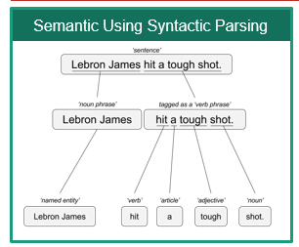
8_Open_Language_Processing.R
library(openNLP)
Setup
https://rpubs.com/lmullen/nlp-chapter
Uses Annotators to identify the specific item in the corpus. Then holds all annotations in a plain text document. Think of auto-tagging words in a document and saving the document terms paired with the tag.
Documentation, examples are hard to come by!
Annotations
Grammatical or POS (Part of Speech) Tagging
Sentence Tagging
Word Tagging
Named Entity Recognition
Persons
Locations
Organizations

Slide 78
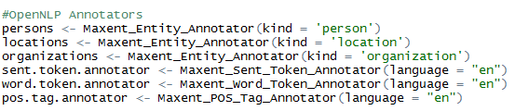
8_Open_Language_Processing.R
Setup
Annotations Specified
Annotations Applied to Text
Annotate is used in ggplot2 SO you must either change the above to NLP::annotate(…) or ensure ggplot2 is not loaded in your environment!

Slide 79
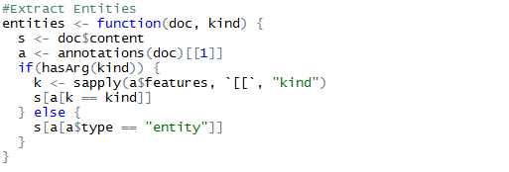
8_Open_Language_Processing.R
Setup
The annotated plain text object is large with a complex structure. This function allows us to extract the tokens by tag kind.

Slide 80
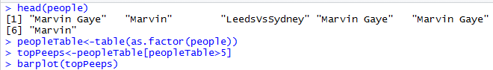
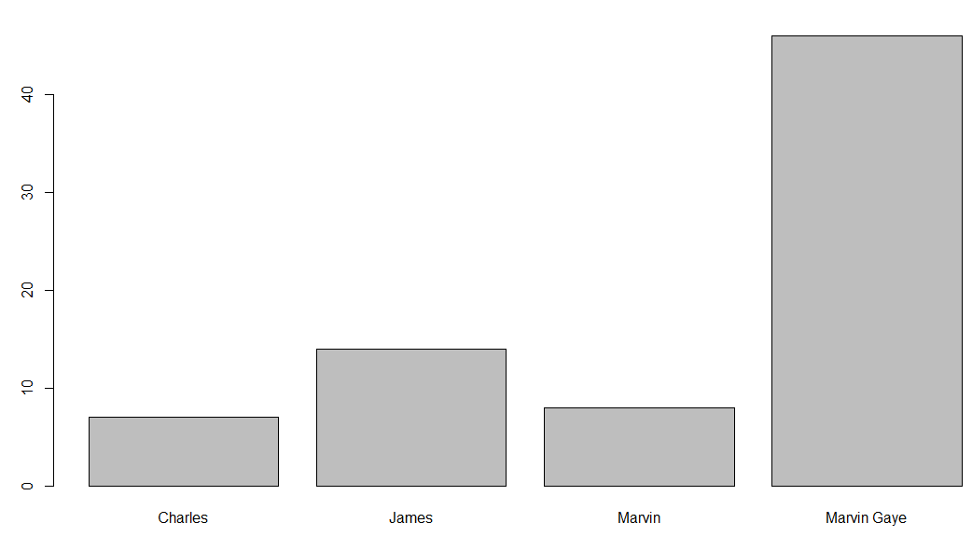
8_Open_Language_Processing.R
The function creates a vector of people, locations and orgs that were “recognized”
Setup

Slide 81
8_Open_Language_Processing.R

Slide 82
Workshop Agenda
9-10:45
Intro to TM w/R
10:45-11
Break
11 – 11:45
Gather Text
11:45 – 12
Break
12-12:40
HTML Widgets
& Flexdashboard
12:40-12:50
Optional
Break
12:50-1
Scheduling
Goals:
Learn the basics of text mining
Apply methods to real data
Follow a business workflow for stakeholders needing text mining insights

Slide 83
Review: read.csv()
To read a single “comma separated value” file (.csv):
text<-read.csv('coffee.csv', header=TRUE)
Part of utils package installed with base R. Used for tabled data with a “delimited” to create a data.table.
Example: 1_Keyword_Scanning.R
Some of the alternatives include:
Package::Function | Description
data.table::fread() | Fast And Friendly File Finagler
readr::read_csv() | Read A Delimited File (Including Csv & Tsv) Into A Tibble
ff::read.csv.ffdf() | “Imports csv files into ff data frames (memory-efficient storage of large data on disk and fast access functions)
sqldf::read.csv.sql() | Read File Filtered By SQL statement
bigmemory::read.big.matrix() | Package for working with “massive matrices” File Interface For A ``Big.Matrix'‘ class

Slide 84
Review: read.csv() with Multiple Files*
Start with a vector of .csv files OR you can use
txtFiles<-c('chardonnay.csv','coffee.csv','beer.csv')
OR if you have a folder with many
txtFiles<-list.files(pattern = “*.csv”)
Example: 5_Other_Wordclouds.R
A For loop will read each file individually and add it to the environment.
for (i in 1:length(txtFiles)){
assign(txtFiles[i], read.csv(txtFiles[i]))
cat(paste('read completed:',txtFiles[i],'\n'))
}
Using lapply or pblapply (personal preference) will put all individual files into a single list
all<-pblapply(txtFiles,read.csv)
rbindlist() from data.table is an efficient way to collapse the list of documents if needed.
*You can actually use this code to read other file types if you change read.csv

Slide 85

Plain Text files: readLines()
# Data
text<-readLines('Weeknd.txt')
Example: 6_TidyText_Sentiment.R

Slide 86


Now onto APIs!!
Mashape.com
ProgrammableWeb.com
Plus literally millions of others waiting to be found!

Slide 87

Getting Text from an API: What is an API?
Application Program Interface (API)
Clearly defined methods of communication between various software components.

Slide 88




APIs are behind many of the sites you use today.
Google Maps API Services include
Geocoding (get lat/lon from name & vice versa)
Base map “tiles”
Basic Geographic Info
www.google.com/maps/place/Cleveland,+OH/@41.4951143,-81.8462865,11z
maps.googleapis.com/maps/api/staticmap?center=cleveland,+oh&zoom=10&size=640x640&scale=2&maptype=terrain
maps.googleapis.com/maps/api/geocode/json?address=cleveland&sensor=false

Slide 89

In our diagram, the browser/maps interface…
“Your Chrome browser interacts with the maps API services to render the information.

Slide 90




APIs can help unlock information…
Need song lyrics?
Access the Closed Caption API file called “timedtext.
https://www.youtube.com/watch?v=34Na4j8AVgA

Slide 91
Two popular formats.
XML – Extensible Markup Language
Extensible Markup Language is a markup language that defines a set of rules for encoding documents in a format that is both human-readable and machine-readable.
Ever wonder why Excel files went from xls to xlsx? The data is stored as XML.
JSON- Javascript Object Notation
is an open-standard file format that uses human-readable text to transmit data objects consisting of attribute–value pairs and array data types.
Respone in XML or JSON
Ask a question

Slide 92


Comparing the two formats
http://maps.googleapis.com/maps/api/geocode/xml?address=boston&sensor=false
http://maps.googleapis.com/maps/api/geocode/json?address=boston&sensor=false

Slide 93
Types of API requests
HTTP GET - Use GET requests to retrieve resource representation/information only e.g. your browsers GETs google map information
HTTP POST/PUT - Use POST APIs to create new subordinate resources e.g. you post a file to kaggle, it is scored and the response is a change in your ranking
HTTP DELETE - DELETE APIs are used to delete resources
HTTP PATCH – PATCH requests are to make partial update on a resource e.g. updating an existing customer record
Generally, a response in the 200s, is a success and anything in the 400s is considered a failure for various reasons.

Slide 94
Let’s try an API
Request Helpers:
www.Hurl.it
PostMan Chrome Add-in or software
Simple API interactions
https://newsapi.org/
https://pipl.com/dev/demo
http://maps.googleapis.com/maps/api/staticmap?center=Boston+MA&zoom=10&size=640x640

Slide 95
Files to Open
XML Example
https://github.com/kwartler/ODSC/blob/master/p2_Get_Text/GetXML.R
GetXML.R
JSON Example
https://github.com/kwartler/ODSC/blob/master/p2_Get_Text/instruction_newsAPI.R
instruction_newsAPI.R

Slide 96
Workshop Agenda
9-10:45
Intro to TM w/R
10:45-11
Break
11 – 11:45
Gather Text
11:45 – 12
Break
12-12:40
HTML Widgets
& Flexdashboard
12:40-12:50
Optional
Break
12:50-1
Scheduling
Goals:
Learn the basics of text mining
Apply methods to real data
Follow a business workflow for stakeholders needing text mining insights

Slide 97



HTML Widgets
www.HTMLWidgets.org
Let’s an R programmer use JavaScript libraries!
Dynamic meaning a user can interact with the plot
Easy to do from within the R console without JS knowledge
“ships” with all the underlying data, so basic exploration/plotting doesn’t need a Shiny or OCPU backend.
http://www.htmlwidgets.org/showcase_leaflet.html
http://www.htmlwidgets.org/showcase_threejs.html
http://www.htmlwidgets.org/showcase_dygraphs.html

Slide 98
instruction_htmlWidgets.R

Slide 99

FlexDashboard
http://rmarkdown.rstudio.com/flexdashboard/
Let’s an R programmer use HTML with Javascript!
Embed the htmlwidgets, or other plots
Easy to do from within the R console without HTML knowledge
Easily change the layout of the dashboard.
Authoring is done in Rmarkdown (.Rmd) files by “knitting” the components & output is HTML for easy viewing

Slide 100
Open these files:
blank_dashboard.Rmd
top_focal.Rmd

Slide 101
Workshop Agenda
9-10:45
Intro to TM w/R
10:45-11
Break
11 – 11:45
Gather Text
11:45 – 12
Break
12-12:40
HTML Widgets
& Flexdashboard
12:40-12:50
Optional
Break
12:50-1
Scheduling
Goals:
Learn the basics of text mining
Apply methods to real data
Follow a business workflow for stakeholders needing text mining insights

Slide 102
Open these files:
cronDash.Rmd
cronJob.R

Slide 103



Use a scheduler to automate the construction & dissemination of your work!
R Studio cronR Add-In
*Windows task scheduler will be similar.

